Slide 1
HANDLOOM FASHION PRODUCTS TO GLOBAL BUYERS

Slide 2
Types of Handloom Products
Heading: Popular Handloom Fashion Products
Content:
Sarees, scarves, stoles, shawls, and dupattas.
Jackets, kurtas, and dresses.
Home decor items like cushion covers, bedspreads, and curtains.
Focus on diversity of fabric: silk, cotton, wool.

Slide 3
Key Features of Handloom Fashion
Heading: Why Choose Handloom Fashion?
Content:
Unique craftsmanship, one-of-a-kind designs.
Sustainability and eco-friendliness.
Cultural heritage and artisanal value.
High quality and comfort.
Long-lasting durability and handwoven appeal.

Slide 4
The Global Demand for Handloom
Heading: Global Appeal of Handloom Products
Content:
Growing interest in ethical, sustainable fashion.
Increasing awareness of slow fashion and artisanal crafts.
Global buyers seeking handmade, eco-conscious products.
Market trends in Europe, USA, and Asia for handloom textiles.

Slide 5
Handloom and Sustainable Fashion
Heading: Handloom: A Green Alternative
Content:
Low carbon footprint compared to fast fashion.
No use of electricity in weaving.
Biodegradable and natural dyes used in production.
Supporting local weavers and artisans promotes fair trade.

Slide 6
Challenges in Reaching Global Buyers
Heading: Challenges in Marketing Handloom Fashion
Content:
Lack of digital presence for many artisans.
Competition with mass-produced, cheaper alternatives.
Logistic barriers and export regulations.
Difficulty in maintaining the balance between traditional techniques and global trends.

Slide 7
Opportunities for Expansion
Heading: Expanding Handloom Fashion Globally
Content:
Utilizing e-commerce platforms for global reach.
Collaborating with international designers and influencers.
Leveraging social media to tell the story of artisans.
Investment in sustainable fashion initiatives and fair trade certifications.

Slide 8
Case Study
Heading: Successful Handloom Brand Example (You can choose an actual example or create a fictional one)
Content:
Case study of a brand or initiative successfully exporting handloom products.
Discuss their business model, marketing strategies, and impact on global buyers.

Slide 9
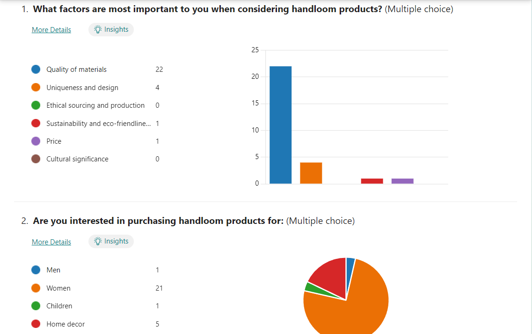

Slide 10
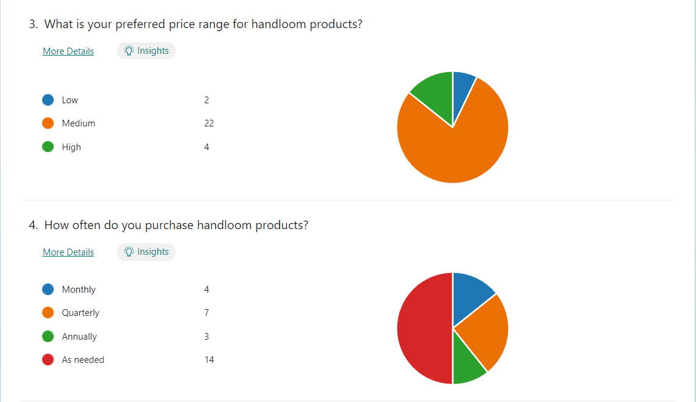

Slide 11
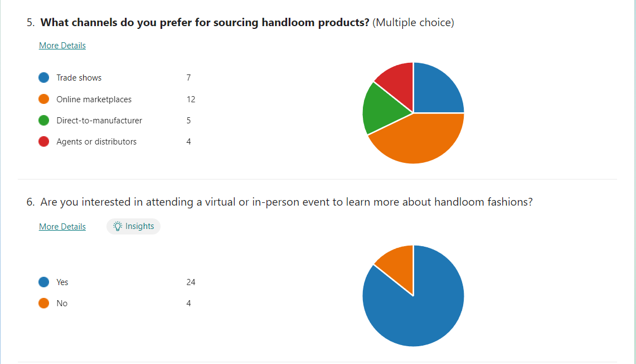

Slide 12
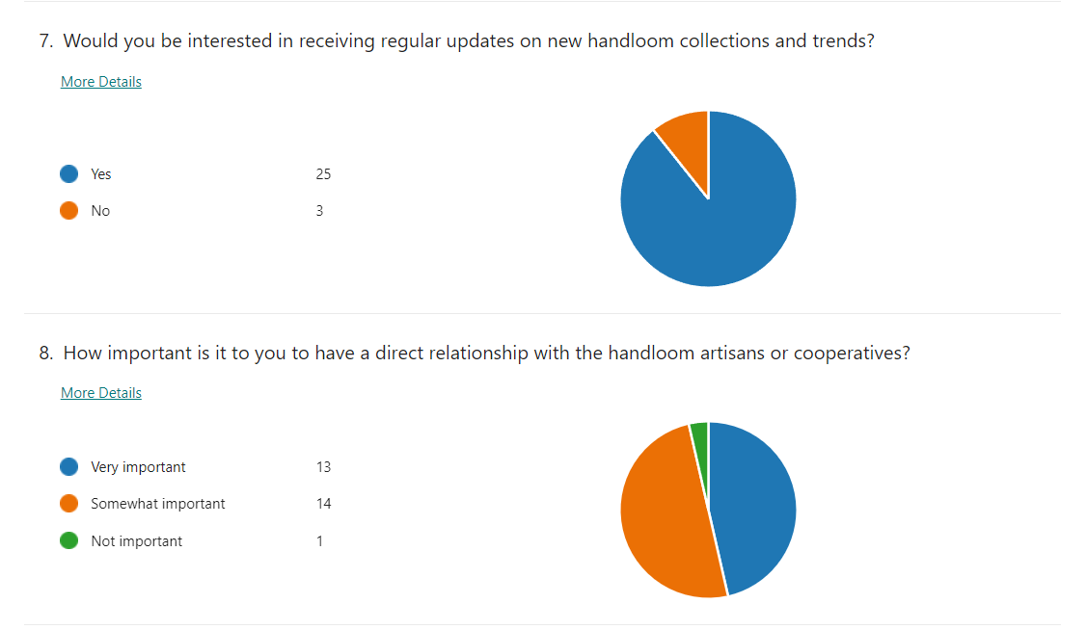

Slide 13
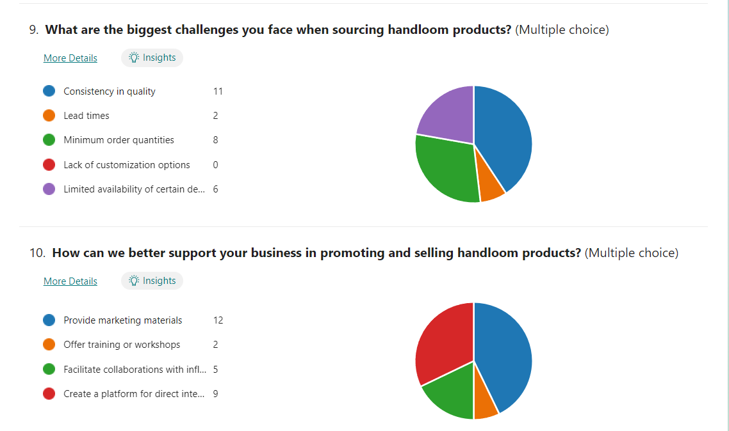

Slide 14
Conclusion
Heading: Handloom Fashion: The Future of Sustainable Fashion
Content:
Recap of handloom’s potential to meet global fashion trends.
Importance of preserving traditional crafts while adapting to global demands.
Encouraging global buyers to embrace slow, sustainable fashion with handloom products.

